Slide 1
Learning Management System

Slide 2
By:
Rene Aguilar – Programmer
Estefany Lemus = Visual Prog
Ana Aguilar = Visual Prog
Luis Dominguez -– Programmer
Vincent Guerrero = Visual Prog
Hung Ngo = Backup prog

Slide 3
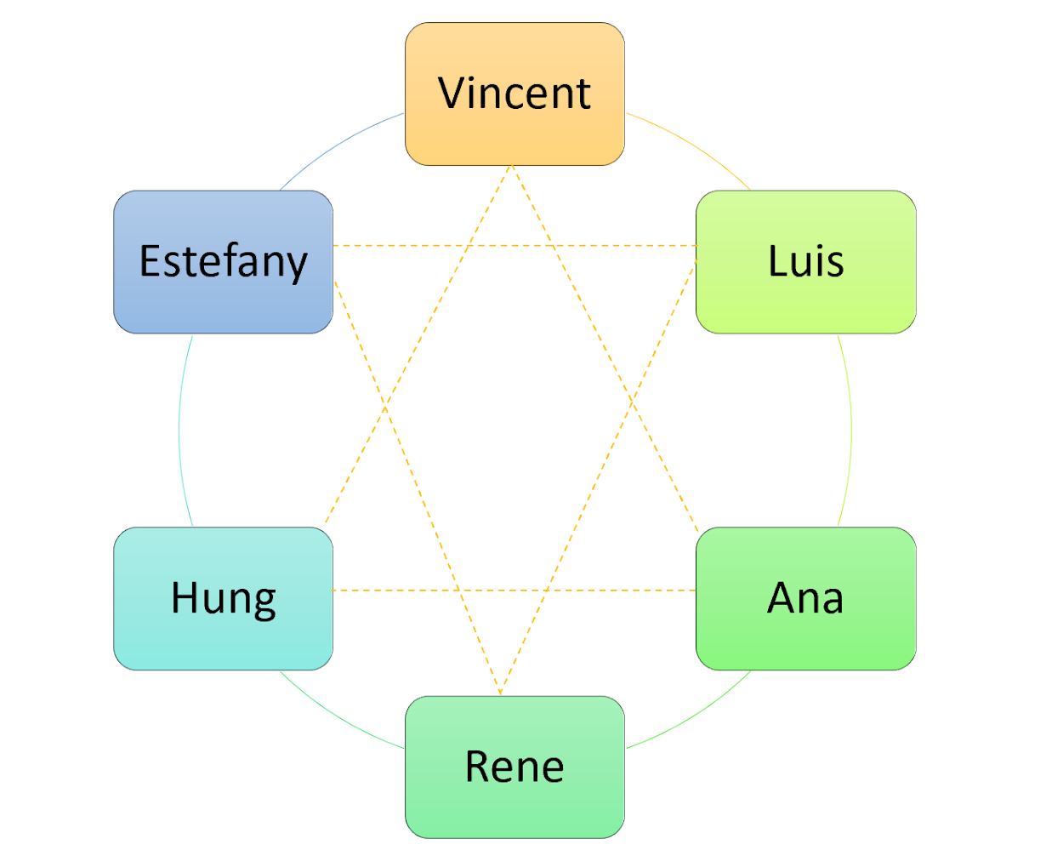
Democratic team organization
Major advantage = positive attitude toward the finding of faults.
What is important is team identity and mutual respect.
AKA “ Egoless programming”

Slide 4
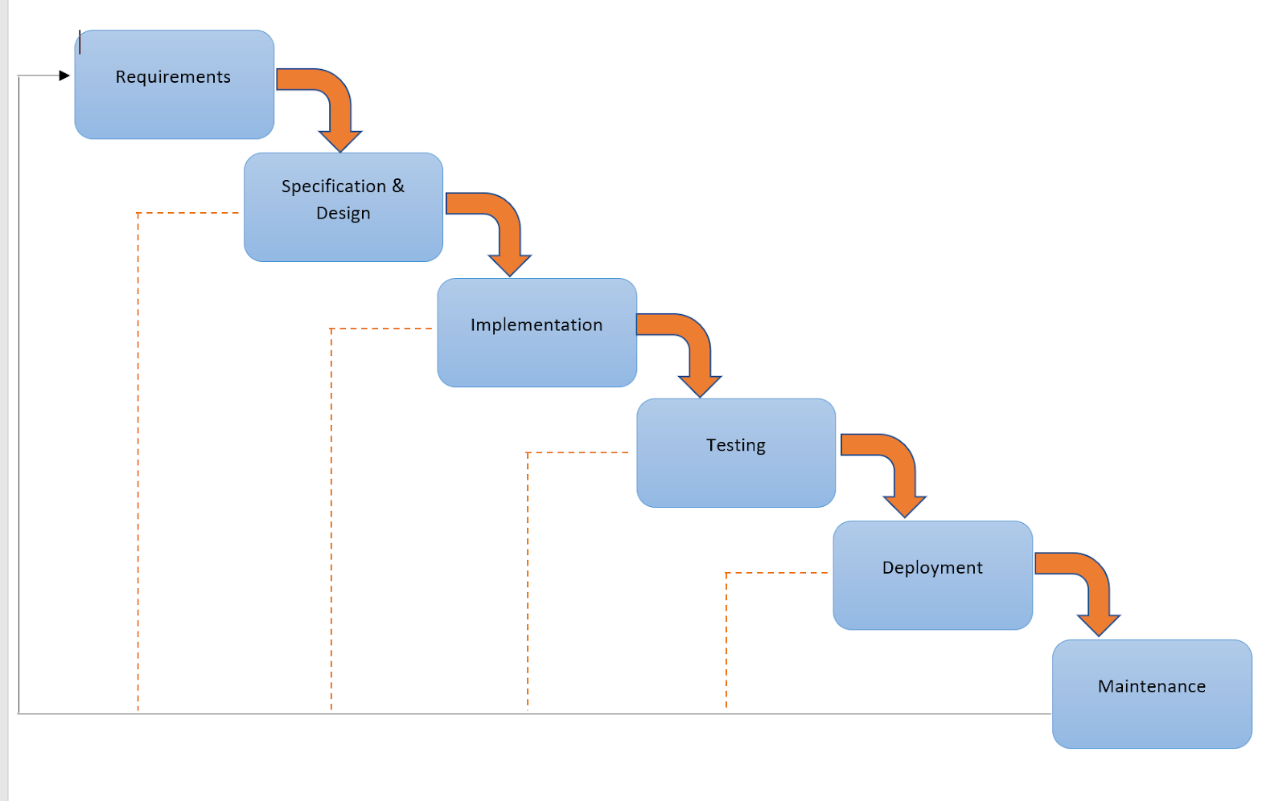
Waterfall Life-cycle model
Determines the end goal early
Transfers information well
Uses clear structure

Slide 5



Techniques
QT
MySQL
C Sharp
Gui
Database
Gui

Slide 6
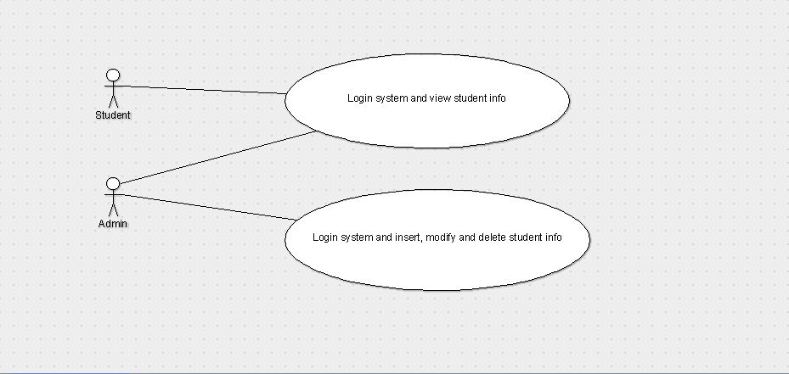
Use Case

Slide 7
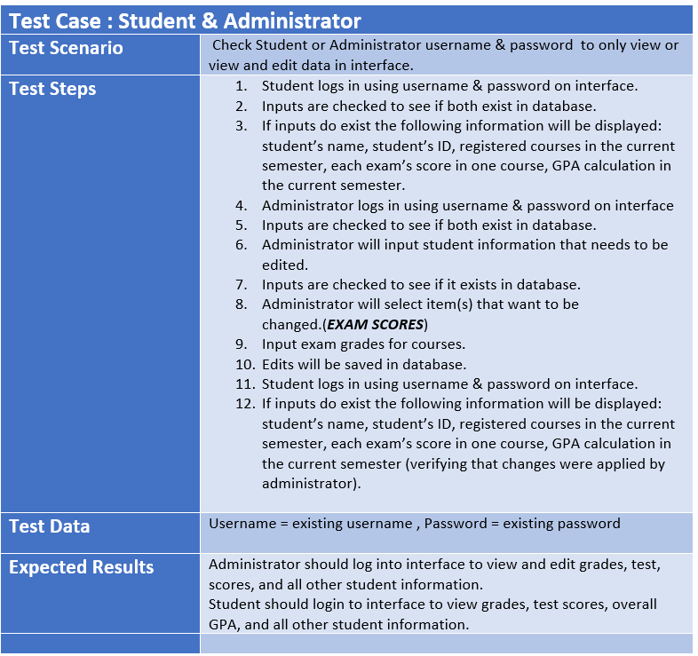
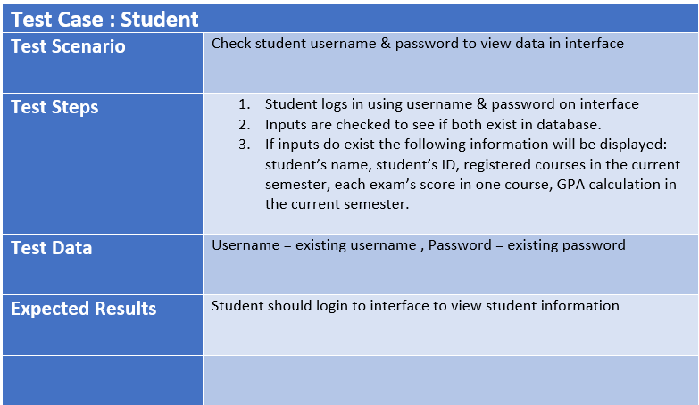
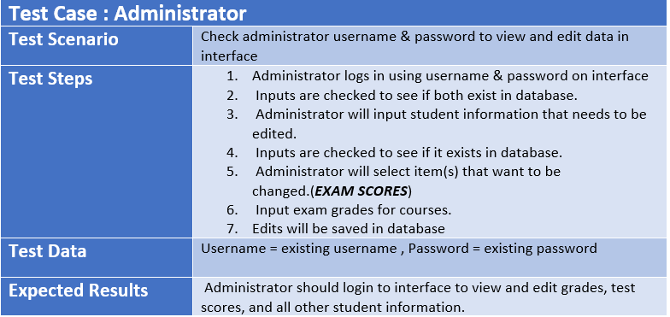
Test Cases

Slide 8
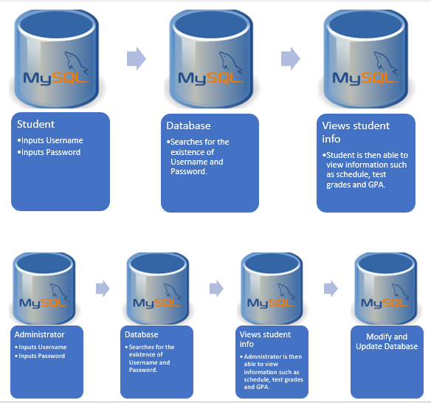
Architectural Design

Slide 9
Software Project Management Plan (SPMP)
https://docs.google.com/document/d/1vrxQcCSiORNYyZNvBnqvC6q7kMh5E5cP32IVqn6d4As/edit?ts=5cf965fc#

Slide 10
Demo

Slide 11
FIN

